Slide 1

GROUP NUMBER : 6 PROJECT ON : QUIZ EVALUATION SOFTWARE
Submitted by:
Shaik Sameera(46281983)
Sai Deepthi Vagu(46281977)
Bhavani Nimmakayala(46282011)
Venkata Radha Golla(46282010)
Ramya Sri Mogilisetti(46281056)

Slide 2
CONTRIBUTION OF GROUP MEMBERS:
Shaik Sameera : Coding and Documentation
Sai Deepthi Vagu : Coding and Testing
Bhavani Nimmakayala : Coding and Testing
Venkata Radha Golla : Coding and Testing
Ramya Sri Mogilisetti : PPT and Documentation

Slide 3
INTRODUCTION:
This project aims to create the development of an Quiz Evaluation Software (QES) application in which trainers will be able to continously keep the record of student marks.
This software helps trainers to evaluate marks of student and store in a document and can be accessed anytime, anywhere.

Slide 4
WORKING PRINCIPLE:
QES portal consists of only one module which is evaluation .
This software will take question paper sheet and answer sheet of a student and then this software will evaluate the marks and update in the output(csv file).

Slide 5
SYSTEM REQUIREMENTS:
System should have ubuntu Linux installed.
System should have either 4GB or more RAM.
The service is used preferably on a desktop or laptop.

Slide 6
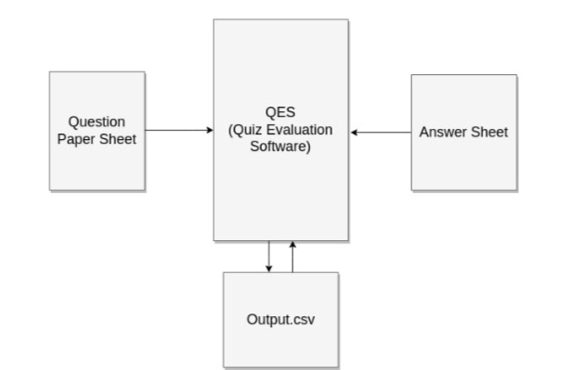
DESIGN:

Slide 7
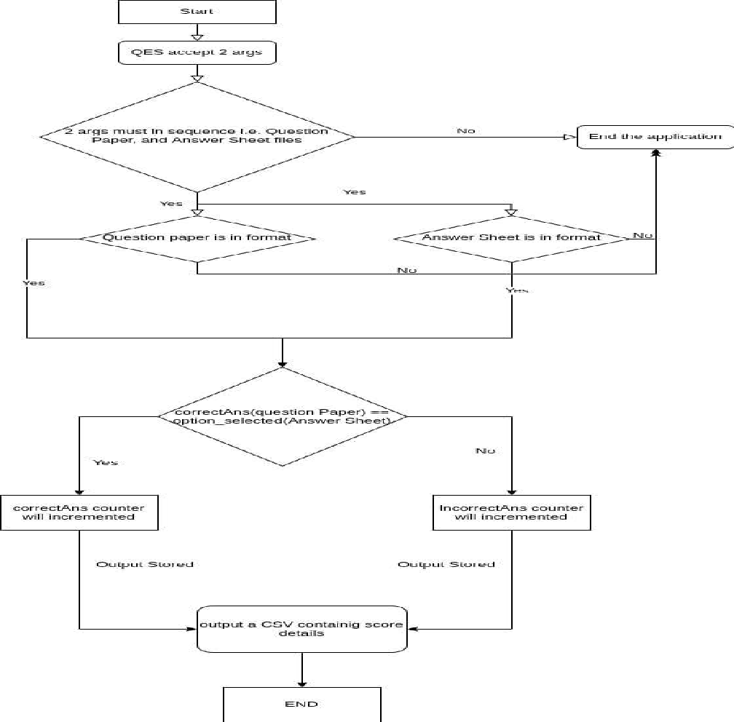
FLOW CHART :

Slide 8
SYSTEM FUNCTIONLITY:
Evaluation Module: The main logic behind QES is written in this module.
QES_01-> evaluate(): Read the columns of Answer sheet and Question paper sheet and put the Question ID and Answer option in the respective structure array.
Output Module: This module help to create a output CSV file.
QES_01-> output_csv(): After this function is called it will open the
output file if exists in the given path. It will update the evaluated marks
of that participant at the end of file.

Slide 9
SYSTEM FEATURES :
Supportability: The system is easy to use.
Design Constraints: The system is built using only C language.
Reliability & Availability: The system is available 24/7 that is whenever the user would like to use the system, they can use it up to its functionalities.
Performance: The system will work on the user’s terminal.

Slide 10
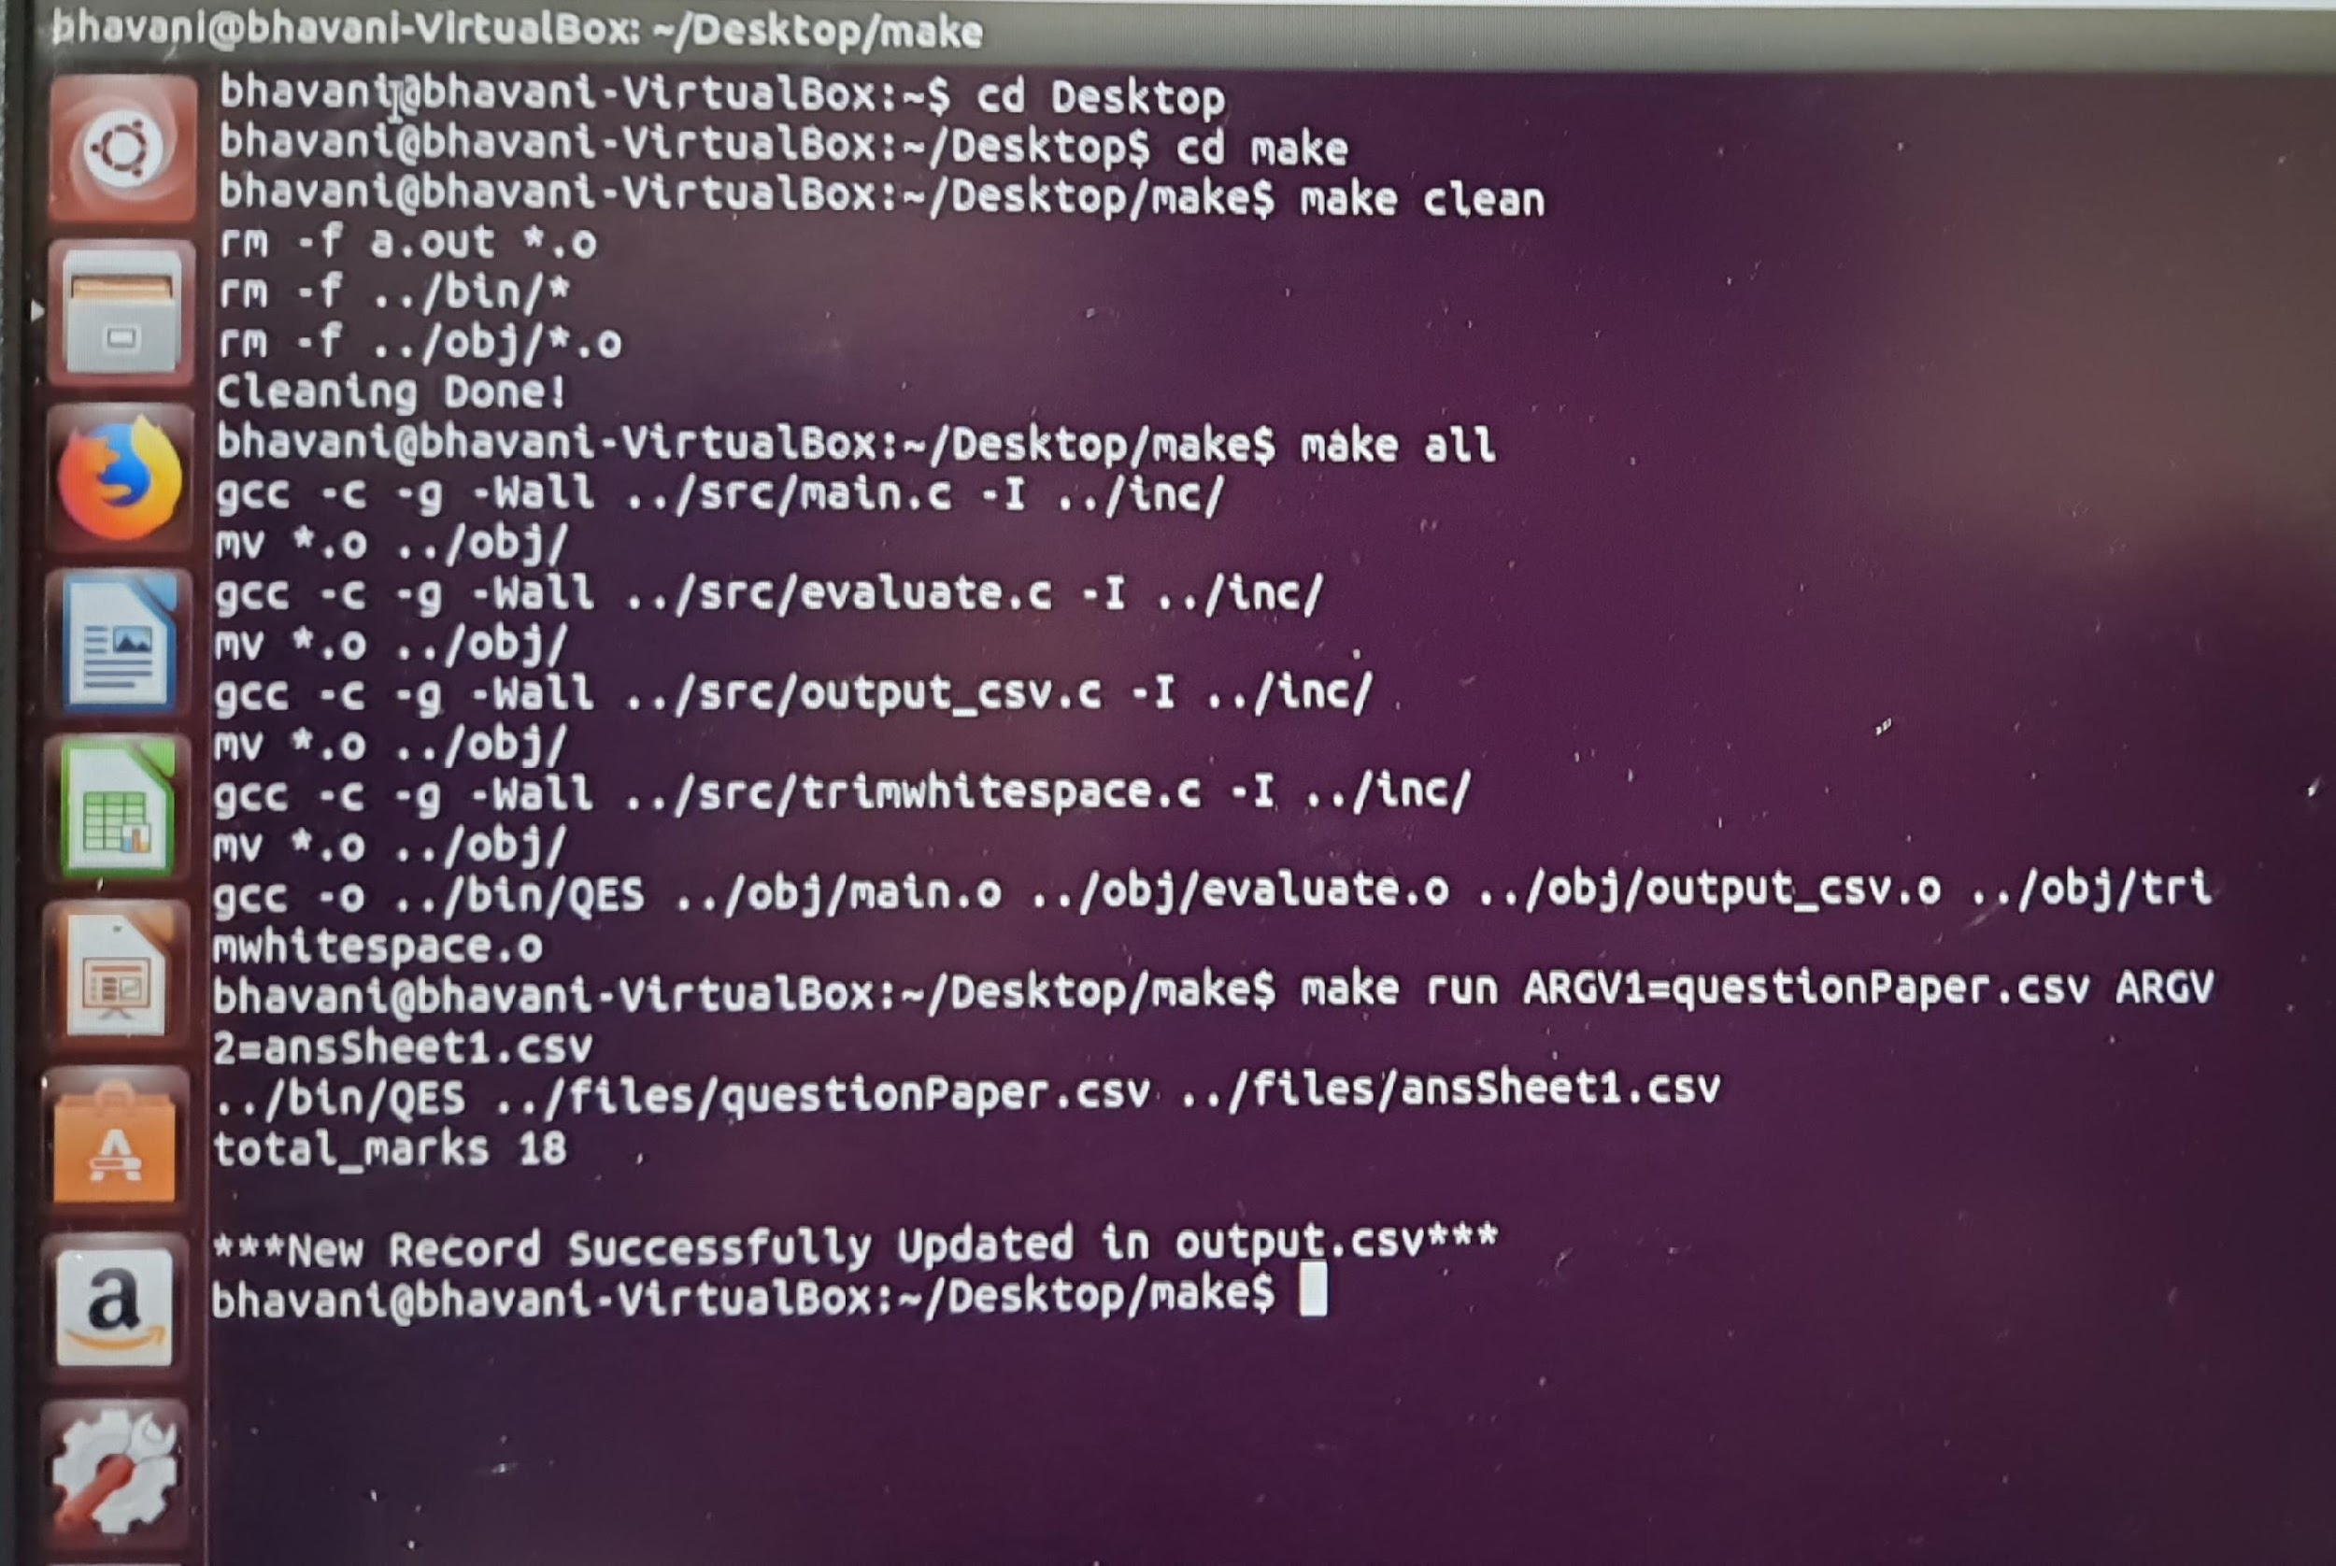
OUTPUT SCREEN 1 :

Slide 11
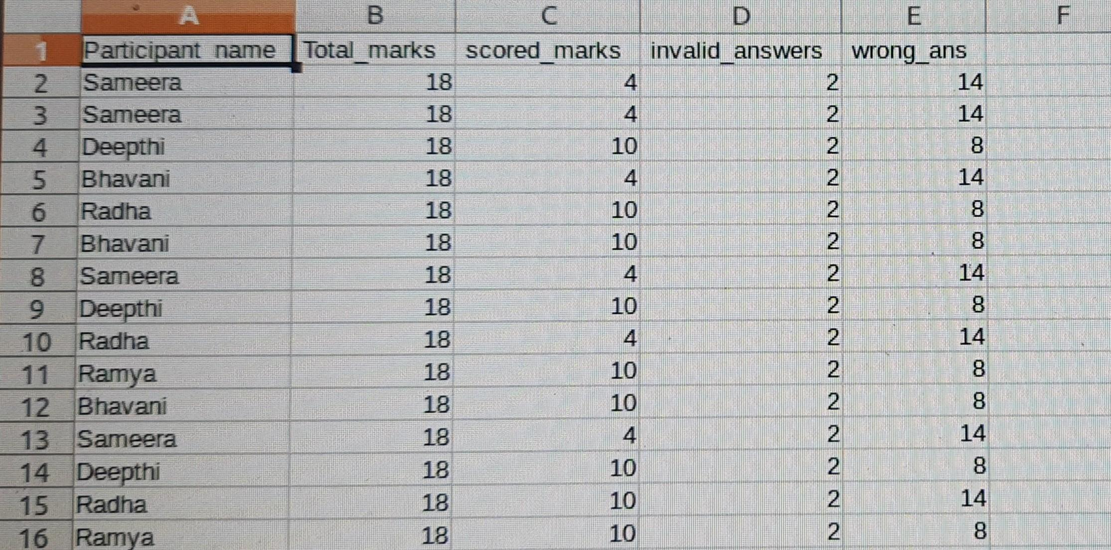
OUTPUT SCREEN 2:

Slide 12
CHALLENGES FACED:
We were having some issues in reading the CSV file initially.
We overcame that problem by referring some questionnaires from Online websites and then we followed some tutorial videos and articles.

Slide 13
CONCLUSION:
This project has helped us in getting clearer understanding of a real world application development .
It provides access to test results and computation of overall result statistics.

Slide 14
THANK YOU

